Slide 1


Creating a Flight-info Data Pipeline
Vivian Do | Stephen Reagin | Mohammad Mahmoudighaznavi

Slide 2
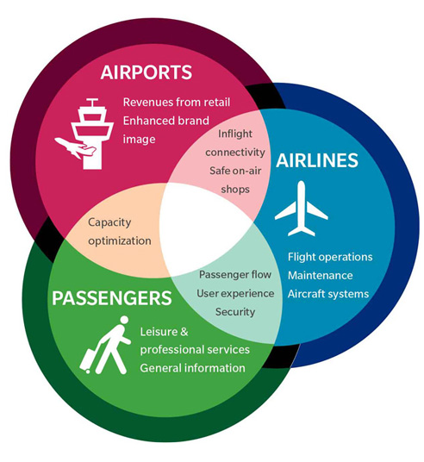
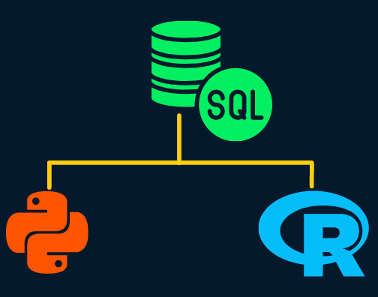

Introduction

Slide 3


Data Source
All raw data comes from the open source anyflights project* using their recommended R-based API calls
Result of 30 CSV files covering 4 airports:
5 airlines dictionary files
5 daily flights files
20 hourly weather files
Weather files required manual edits to resolve import errors, removing first 5 rows of fluff
The largest files were roughly 20-25MB and thus shareable through our team GitHub
*The ultimate source of anyflights data comes from the Bureau of Transportation Statistics (BTS) https://www.bts.gov/

Slide 4
Data Description
Airlines (5 files)
1 file per year covering all 4 airports A dictionary between acronym and airline e.g. DA == Delta Airlines
Airlines
Flights
Weather
~Five~ years
Jan 2018 – Oct 2022
Houston (IAH)
New York (JFK)
San Diego (SAN)
Seattle (SEA)
Flights (5 files)
1 file per year covering all 4 airports Daily listing of flights: Carriers, dates, departure times, destinations, delays, distance
Weather (20 files)
1 file per airport per year Hourly and 5-minute increments of: Temperature, precipitation, windspeed, wind direction, etc.

Slide 5

ETL Methodology​
Extract
Weather, flights, airlines data from anyflights R package
Transform
Manual processing of flights and weather CSV files
Load
Database schema created using MySQL Workbench server
Code Review
Check for consistency between local systems
Includes audit/monitoring SQL script

Slide 6
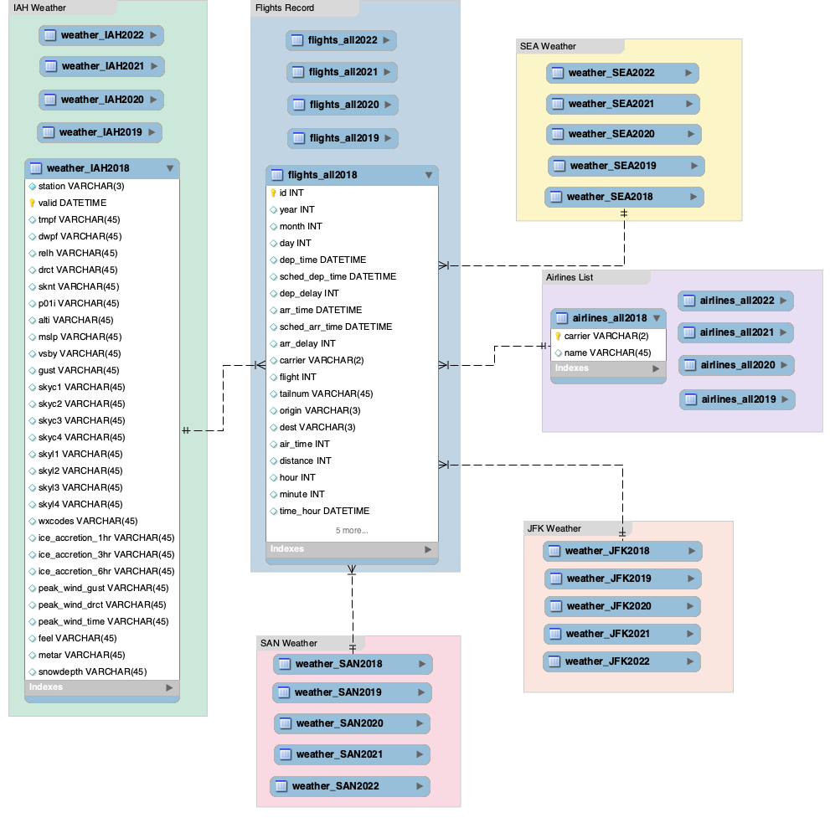

Architecture Diagram

Slide 7

Data Pipelines Purposes
Curated information on flight delays for travelers
Average arrival and departure delays for airline analysts
Daily aggregates of precipitation and flight delays for airport

Slide 8
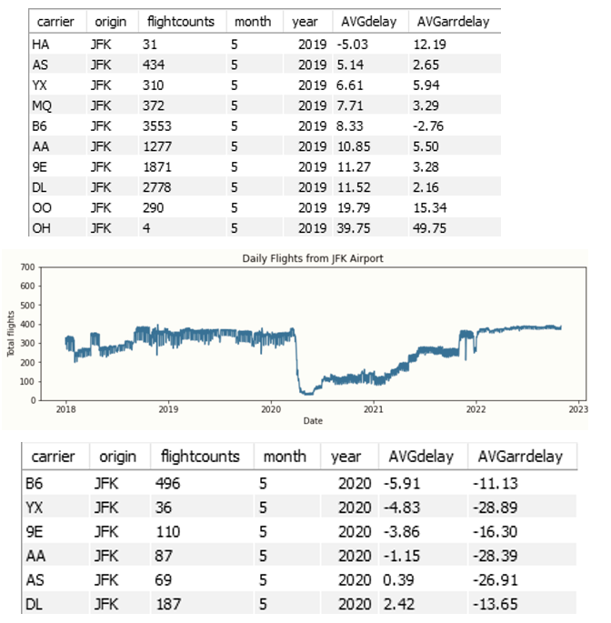
Data Pipelines for Airline Analysis
Which flights had delays over average delay time
Monthly and yearly average and total delays for each carrier
The most average delay based on flight time
Impact of unexpected occurrences on airlines

Slide 9
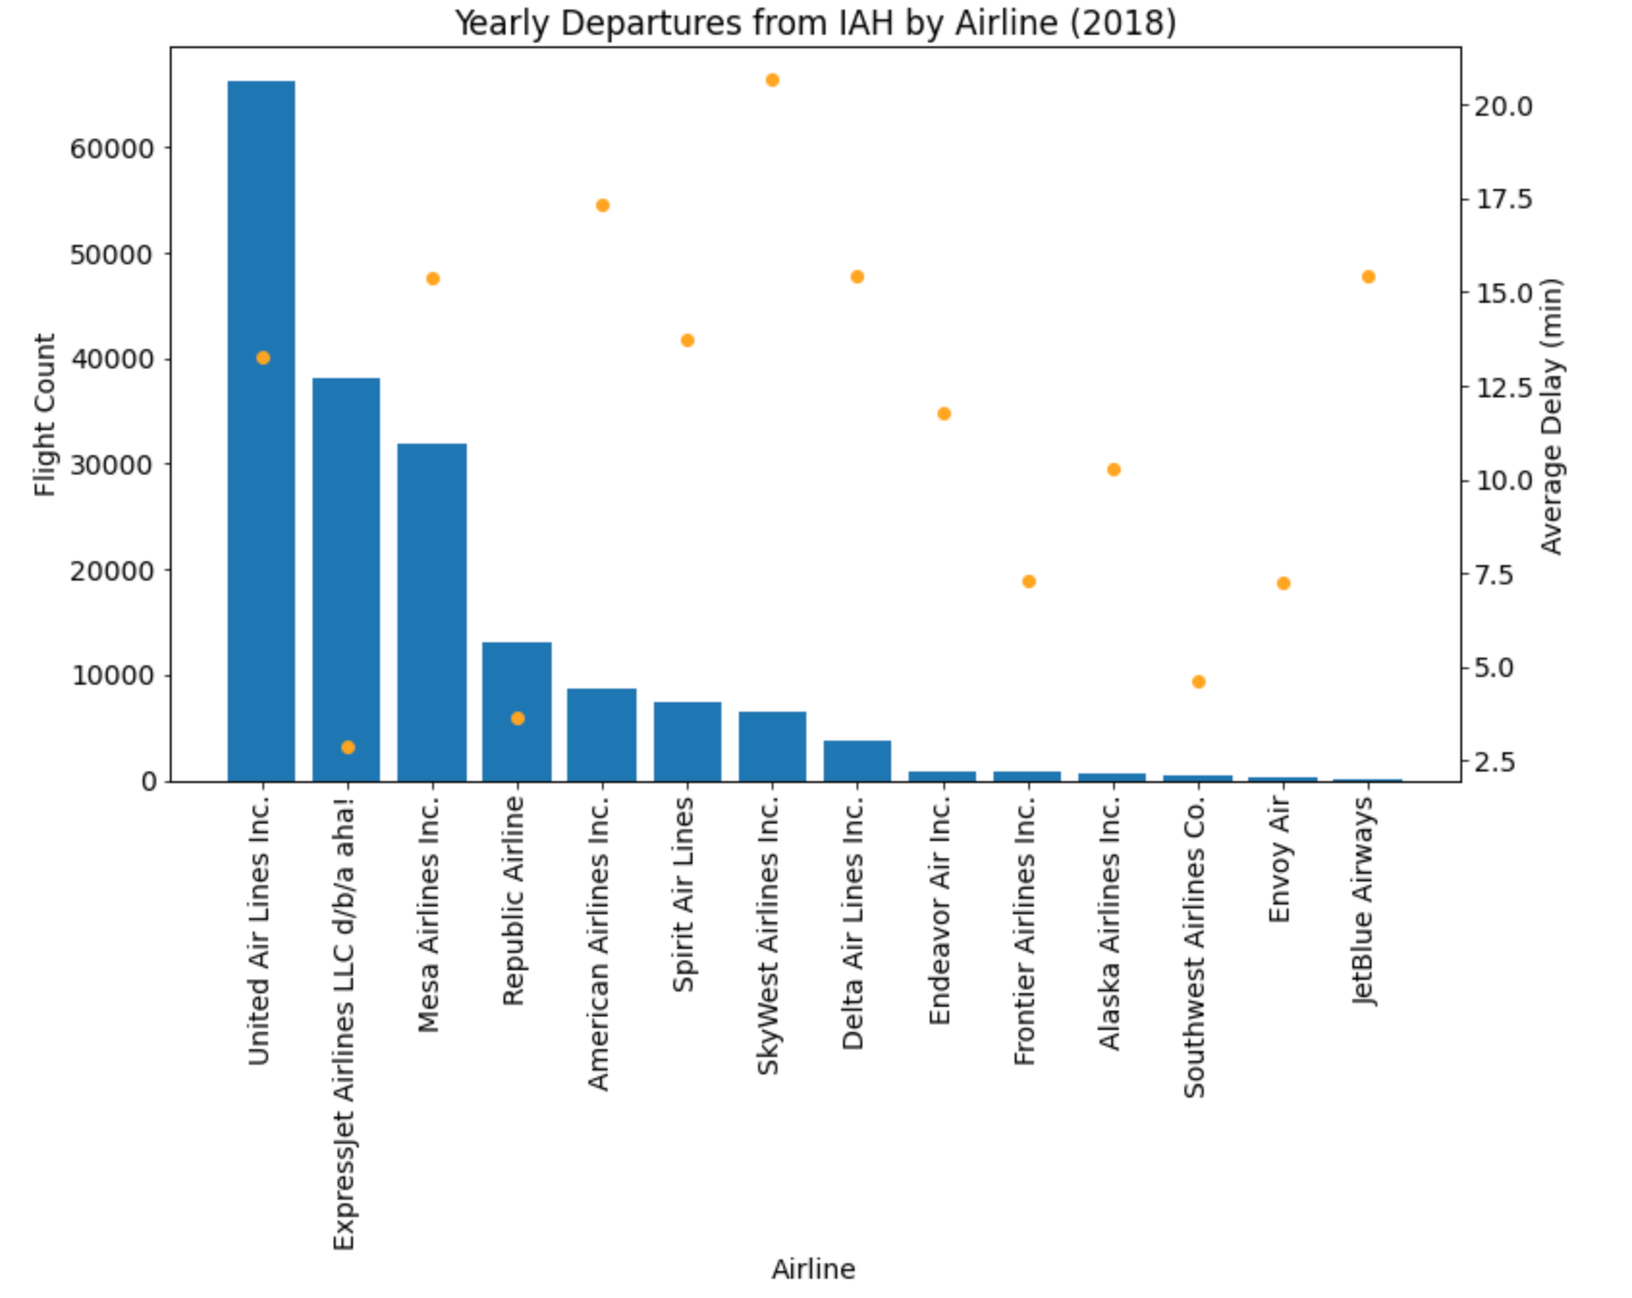
Curated Information for Travelers
Curated flight information for the average consumer, ranging from vacationers to frequent travelers
Example outputs include:
Yearly flight count and average delays by airport for businesspeople
Holiday delays for visiting out-of-state friends and family
List of destinations from home airport for trip planning
General flight information for loyalty rewards programs
Delay by carriers
Seasonal holiday effects
Destination impact
Delays by time of day

Slide 10


Data Pipelines for Airport Consumption
Weather impact on flight delays
Check temperature and precipitation on daily flight schedules
Flight delays caused by flight traffic

Slide 11
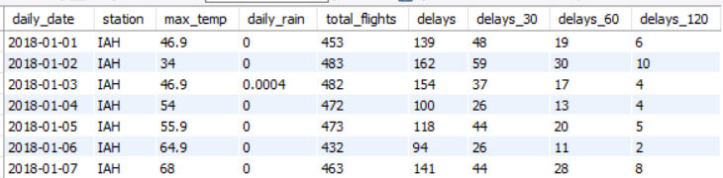
ETL Script for Airport Consumer
Airports will want their own daily flight totals, delays, weather interruptions
We categorize number of daily delays in four ways:
Any delay at all
Any delay above 30min, 60min, 120min
Weather data is in 5min increments so we must create a daily date variable
Rain is cumulative per hour, so we aggregate daily rain totals by summing peak rainfall every hour and group by date
Daily max temperature is the peak measure per date

Slide 12
Next Steps
Partner with relevant stakeholders and implement their feedback
Scale database to more airports
Trigger API calls when BTS updates the data behind anyflights
Redesign our SQL code to extend to future weather and flights files which may come along, rather than SQL hardcoded for specific airports and years

Slide 13
References
Bureau of Transportation Statistics. (n.d.). https://www.bts.gov/
Couch, S. (n.d.). anyflights documentation. Retrieved February 26, 2023 from: https://anyflights.netlify.app/reference/get_flights.html
Hotle, S., & Mumbower, S. (2023). The impact of COVID-19 on domestic U.S. air travel operations and commercial airport service. ScienceDirect, 1-5. Retrieved from ScienceDirect: https://www.sciencedirect.com/science/article/pii/S2590198220301883
McCarthy, D. (2022, April 08). What Are the Most Common Reasons For Flight Delays in the U.S.? Retrieved from travelmarketreport: https://www.travelmarketreport.com/News/articles/What-Are-the-Most-Common-Reasons-For-Flight-Delays-in-the-US
Reis, J. & Housley, M. (2022). Fundamentals of data engineering. O'Reilly.

Slide 14
Thank You!

